Slide 1
8284A Clock Generator
CpE 3104 – Microprocessors
Unit 5: MEMORY INTERFACING
© 2025

Slide 2
Clock Generator
It is a circuit or an electronic oscillator that produces a timing signal (known as a clock signal) for use in synchronizing a circuit's operation.
The signal can range from a simple symmetrical square wave to more complex arrangements.
The basic parts that all clock generators share are a resonant circuit and an amplifier.

Slide 3
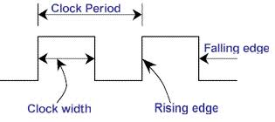
Clock
It is a particular type of signal that oscillates between a high and a low state.
To find the frequency f of a clock signal,
f = 1/p
where: p is period

Slide 4
Applications of Clock Generator
The clock signal in a microprocessor allows synchronization of several components of the microprocessor.
The time base for synchronization of the internal and external operations of the microprocessor in a microcomputer system is provided by the clock (CLK) input signal.
The correctness of the computation of the microprocessor depends upon the efficient and balanced distribution of the clock signal (the clock generator generates the clock signal).
The clock also provides the READY signal for the insertion of wait states into the CPU bus cycle.

Slide 5
8284A Clock Generator
During fetch and execute instructions, the 8086/8088 processors require clock pulse which has about 10 ns rise and fall times.
The logic 0 level of the clock is 0.5 V to 0.6 V, logic-1 level is about 3.9 V to 5 V and the clock duty cycle is about 33%.
The 8086/8088 processor has no clock generator inside the chip, so, an external clock generator IC must be connected with the processor.

Slide 6
8284A Clock Generator
It is an integrated circuit (IC) that is designed specifically for use with the 8086/8088 microprocessor.
Basic functions:
Clock generation
RESET synchronization
READY synchronization
TTL level peripheral clock signal

Slide 7
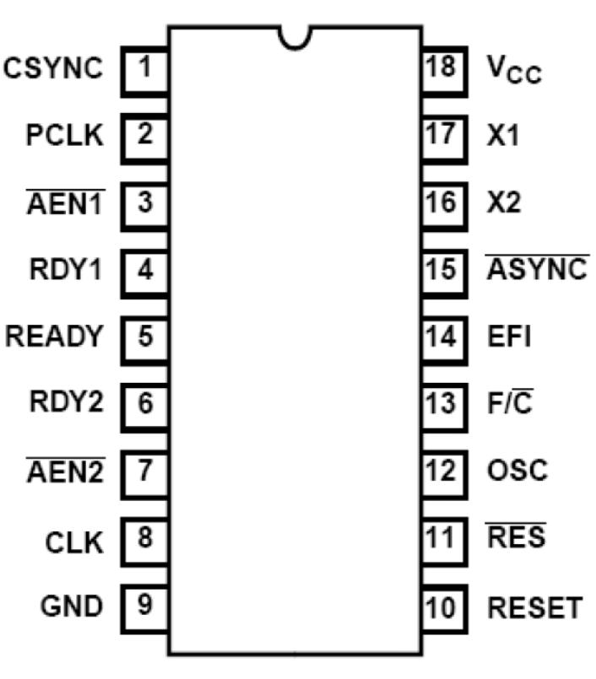
8284A Clock Generator Pin Configuration
8
2
8
4
A

Slide 8
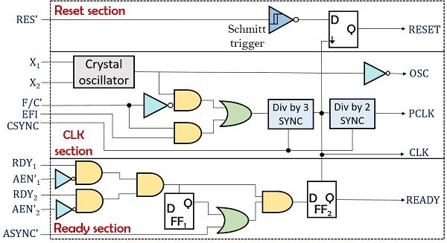
8284A Internal Diagram/Logic Circuit

Slide 9
8284A Clock Generator
Pins and Signals

Slide 10
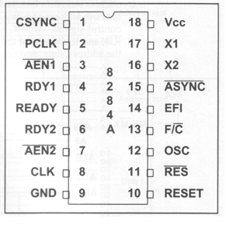
Power Supply Pins
Vcc - (pin#18)
GND - (pin#9)

Slide 11
Input Pins
CSYNC(clock synchronization)
pin#1
RDY1 and AEN1
(ready1 & address enable1)
pin#4; pin#3
RDY2 and AEN2
(ready2 & address enable2)
pin#6; pin#7
X1 and X2 (crystal inputs)
pin#17; pin#16
ASYNC (synchronization select)
pin#15
EFI (external frequency input)
pin#14
F/C (frequency/crystal select)
pin#13
RES (reset input)
pin#11

Slide 12
CSYNC (Clock Synchronization)
This active-high signal is used to allow several 8284 chips to be connected together and synchronized.
The IBM PC only uses one 8284A; therefore, this pin is connected to ground (low).

Slide 13
RDY1 and AEN1
RDY1 is active high and AEN1 (address enable1) is active low.
They are used together to provide a ready signal to the microprocessor, which will insert a WAIT state to the CPU read/write cycle.
In the IBM PC, RDY1 is connected to DMA/WAIT and AEN1 is connected to RDY/WAIT.
They allow the wait state to be inserted either by the CPU or by DMA.

Slide 14
RDY2 and AEN2
These function exactly like RDY1 and AEN1.
These extra RDY signal and AEN signal are provided to allow for a multiprocessing system.
It allows other general-purpose CPUs such as the 8086/8088 to gain control over the buses.
In the IBM PC, RDY2 is connected to low, AEN2 is connected to high, which permanently disables this function since there is only one 8086/8088 µP in the system.
In cases of multiprocessor systems, these signals are used to coordinate access over the buses by different CPUs.

Slide 15
X1 and X2 Crystal Inputs
XI and X2 are the pins to which a crystal is attached.
The crystal frequency must be 3 times the desired frequency for the microprocessor (i.e., If the required frequency is 5 MHz, the crystal frequency will be 15 MHz).
The maximum crystal for the 8284A is 24 MHz and 30MHz for the 8284A-1.
The IBM PC is connected to a crystal of 14.31818 MHz.
For some turbo compatibles, it is 24 MHz.

Slide 16
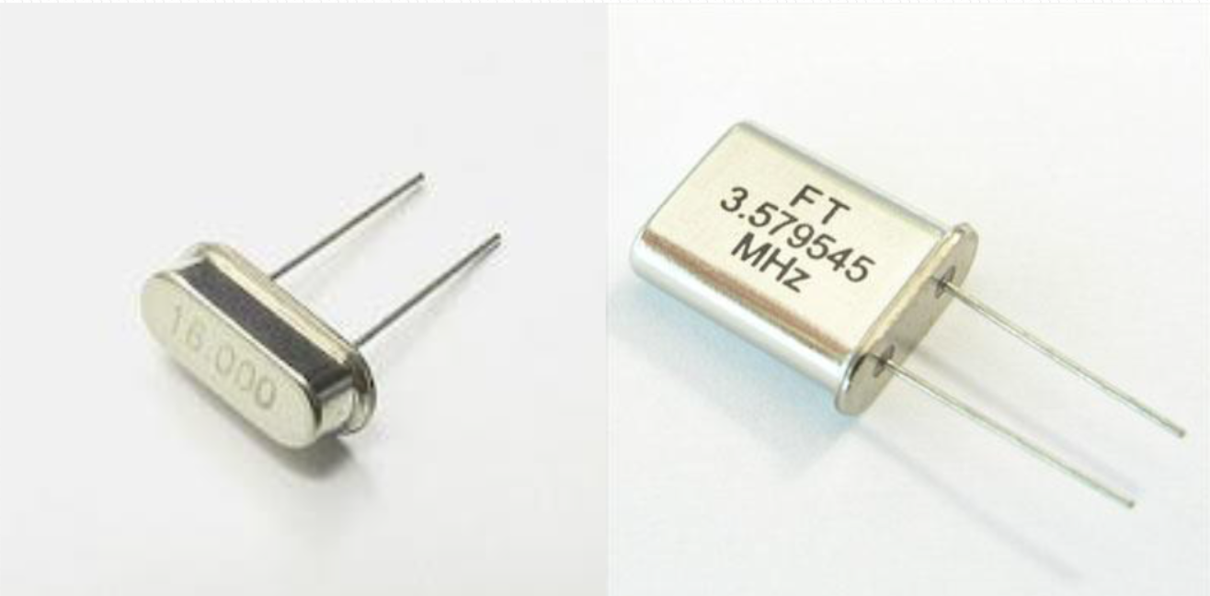
Crystal Oscillator
A crystal oscillator is an electronic oscillator circuit that uses the mechanical resonance of a vibrating crystal of piezoelectric material to create an electrical signal with a very precise frequency.
Types of Crystal Oscillator
Notes:
Oscillate
- to move repeatedly from one position to another
- to move repeatedly from side to side or up and down between two points, or to vary between two states or amounts, or feelings or opinions
Oscillator
- a mechanical or electronic device that works on the principles of oscillation: a periodic fluctuation between two things based on changes in energy
- computers, clocks, watches, radios, and metal detectors are among the many devices that use oscillators
Piezoelectric
- relating to or involving electric polarization resulting from the application of mechanical stress
Piezoelectricity
- the electric charge that accumulates in certain solid materials—such as crystals, certain ceramics, and biological matter such as bone, DNA, and various proteins—in response
to applied mechanical stress.
- means electricity resulting from pressure and latent heat
Piezoelectric resonator is an electronic component designed for electronic oscillators and filters.
Piezoelectric resonators are: crystal resonators (crystal oscillator); polycrystalline resonators (ceramic resonator); MEMS oscillators.
MEMS (Microelectromechanical System) resonators are small electromechanical structures that vibrate at high frequencies.
They are used for timing references, signal filtering, mass sensing, biological sensing, motion sensing, and other diverse applications.

Slide 17
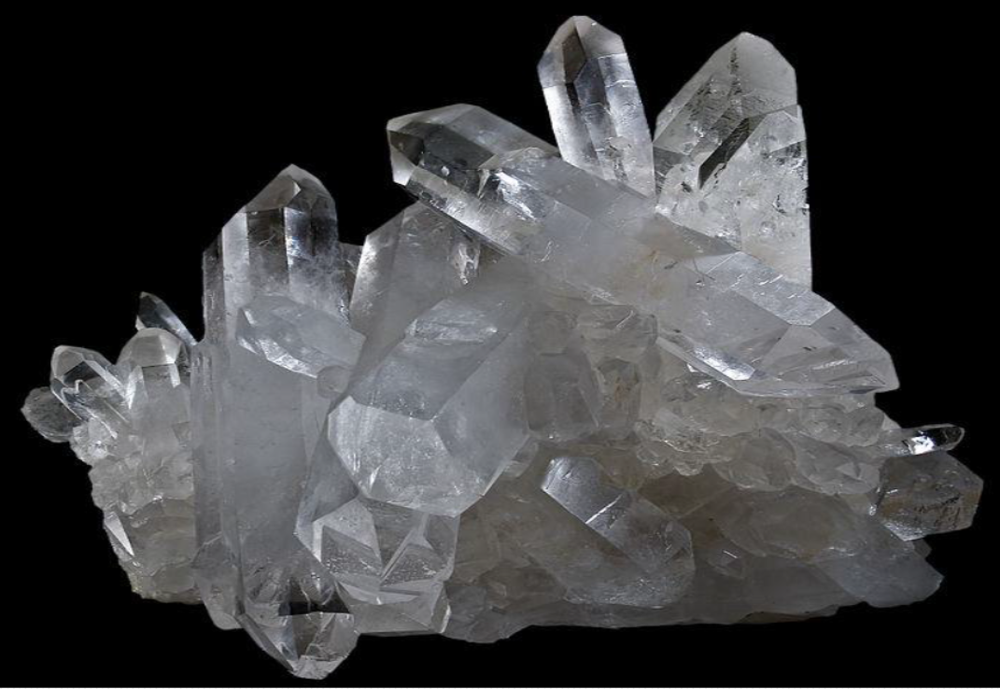
Crystal Oscillator
The most common type of piezoelectric resonator used is the quartz crystal, so oscillator circuits incorporating them became known as crystal oscillators.
Cluster of Natural Quartz Crystals
Notes:
Oscillate
- to move repeatedly from one position to another
- to move repeatedly from side to side or up and down between two points, or to vary between two states or amounts, or feelings or opinions
Oscillator
- a mechanical or electronic device that works on the principles of oscillation: a periodic fluctuation between two things based on changes in energy
- computers, clocks, watches, radios, and metal detectors are among the many devices that use oscillators
Piezoelectric
- relating to or involving electric polarization resulting from the application of mechanical stress
Piezoelectricity
- the electric charge that accumulates in certain solid materials—such as crystals, certain ceramics, and biological matter such as bone, DNA, and various proteins—in response
to applied mechanical stress.
- means electricity resulting from pressure and latent heat
Piezoelectric resonator is an electronic component designed for electronic oscillators and filters.
Piezoelectric resonators are: crystal resonators (crystal oscillator); polycrystalline resonators (ceramic resonator); MEMS oscillators.
MEMS (Microelectromechanical System) resonators are small electromechanical structures that vibrate at high frequencies.
They are used for timing references, signal filtering, mass sensing, biological sensing, motion sensing, and other diverse applications.

Slide 18
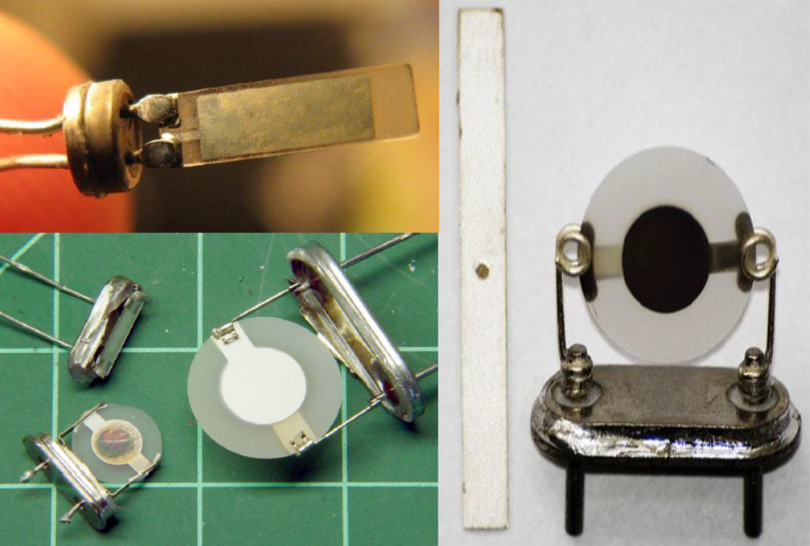
Crystal Oscillator: Operation
When a crystal of quartz is properly cut and mounted (see the figure below), it can be made to distort in an electric field by applying a voltage to an electrode near or on the crystal.
This property is known as electrostriction or inverse piezoelectricity.
Internal Construction of Quartz Crystal Oscillators

Slide 19
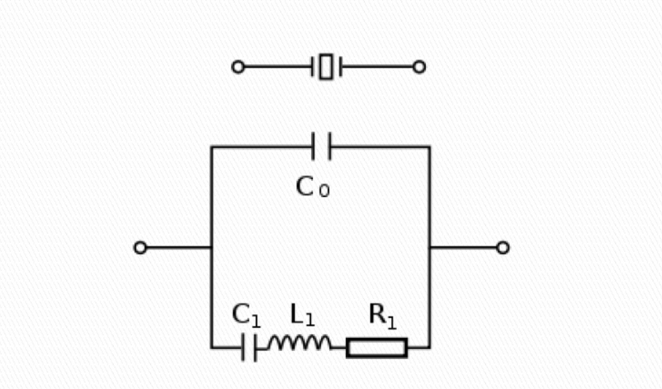
Crystal Oscillator: Operation
When the field is removed, the quartz will generate an electric field as it returns to its previous shape, and this can generate a voltage.
The result is that a quartz crystal behaves like a circuit composed of an inductor, capacitor and resistor, with a precise resonant frequency (see the RLC circuit in the figure below).
Schematic Symbol and Equivalent Circuit for a Quartz Crystal in an Oscillator

Slide 20
ASYNC (Ready Synchronization Select)
Selects either one or two stages of synchronization for the RDY1 and RDY2 inputs.
An active low signal used for devices that are not able to adhere to the very strict RDY setup time requirement.
In the IBM PC, this is connected to low, making the timing design of the system easier with slower logic gates.

Slide 21
EFI (External Frequency Input)
External frequency is connected to this pin if F/C has been connected to high.
In the IBM PC, this is not connected since a crystal is used instead of an external frequency generator.
In some cases (such as the Turbo PC), this pin is used to provide clock frequency in place of XI and X2.

Slide 22
F/C (Frequency/Crystal Select)
This pin provides an option for the way the clock is generated.
If connected to low, the clock is generated by the 8284 with the help of a crystal oscillator.
If connected to high, it expects to receive clocks at the EFI pin.
Since the IBM PC uses a crystal, this pin is connected to low.

Slide 23
RES (Reset Input)
This is an active-low input signal to generate RESET.
The 8284A provides a trigger input so that an RC connection can be used to establish the power-up reset of proper duration.
A low signal is provided to this pin and the 8284 in turn will activate the RESET pin forcing the 8086/8088 microprocessor to reset; then the microprocessor takes over. This is called a cold boot.

Slide 24
Output Pins
PCLK(peripheral clock)
pin#2
Ready
pin#5
CLK(clock)
pin#8
OSC(Oscillator)
pin#12
Reset
pin#10

Slide 25
RESET Output
This is an active-high output signal that provides a RESET signal to the 8086/8088 µP.
It is activated by the RES input signal discussed earlier.

Slide 26
Oscillator
It is a TTL-level signal that is at the same frequency as the crystal or EFI input.
It provides an EFI input to the other 8284A clock generators that are used in some multiprocessor systems.

Slide 27
CLK (Clock)
This is an output clock frequency equal to one-third of the crystal oscillator, or EFI input frequency, with a duty cycle of 33%.
This is connected to the clock input of the 8086/8088 µP and all other devices that must be synchronized with the CPU.
This frequency, 4.772776 MHz (14.31818 MHz divided by 3), is the processor frequency on which all of the timing calculations of the memory and I/O cycle are based.

Slide 28
PCLK (Peripheral Clock)
It is one sixth the crystal or EFI input frequency, and has a 50% duty cycle.
It provides a clock signal to the peripheral equipment in the system.

Slide 29
READY
This signal is connected to READY of the CPU.
In the IBM PC, it is used to signal the 8086/8088 µP to indicate if the CPU needs to insert a wait state due to the slowness of the devices that the CPU is trying to contact.
At low logic, CPU is at wait state.

Slide 30
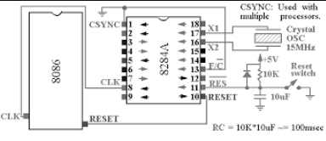
Interfacing 8284A to 8086 Microprocessor
8086 µP
8284A
RESET CIRCUIT

Slide 31
Interfacing 8284A to 8086 Microprocessor

Slide 32
Reset Logic Circuit
Initially the capacitor is uncharged.
When power is switched on, the RES signal is at logic 0 (RESET signal is at logic 1).
The capacitor starts charging with time constant (RC = 10KΩ x 10µF).
When the voltage across the capacitor becomes equal to the minimum High voltage of the 8284 (2V), the RES signal goes to logic 1 (RESET signal goes to logic 0).
If the Reset button is pressed, the capacitor is discharged through the switch.
When the Reset button is released, the capacitor starts charging as before.
The diode is used to short circuit the resistor during switch off, thus, discharge the capacitor fast.

Slide 33
End of Lecture

